Slide 1

Video Game sales analysis

Slide 2

Objectives
Analyse the data along the following patterns for improved sales.
Type of video game.
Platform of video game.
Regional sales of games.

Slide 3
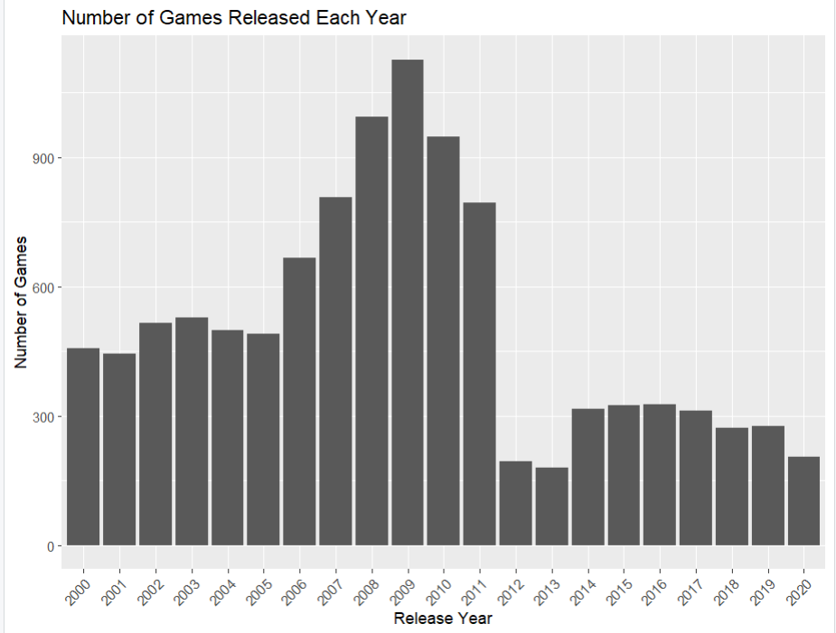
Over the years
There is a distinct peak in the number of games released around the year 2009, with over 900 games being released that year.
The number of games released gradually increased from the early 2000s, leading up to the peak in 2009, indicating a growing video game industry during that period.
However, after reaching this peak, the number of games released declined sharply in the following years, indicating a potential contraction or restructuring within the industry
The sharp decline after the peak in 2009 may also suggest potential shifts or changes within the video game industry, such as the rise of digital distribution, changing consumer preferences, or the emergence of new platforms or business models.

Slide 4
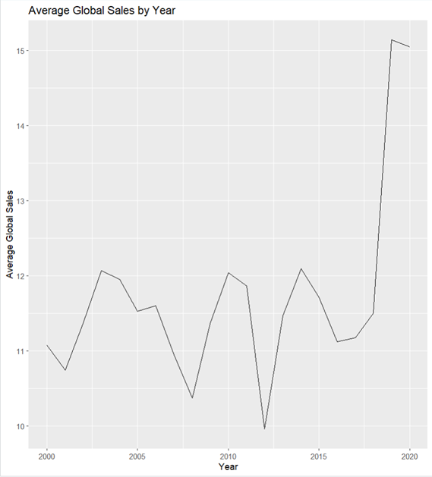

Slide 5

WHAT KIND OF GAMES ARE MOST SOLD??

Slide 6
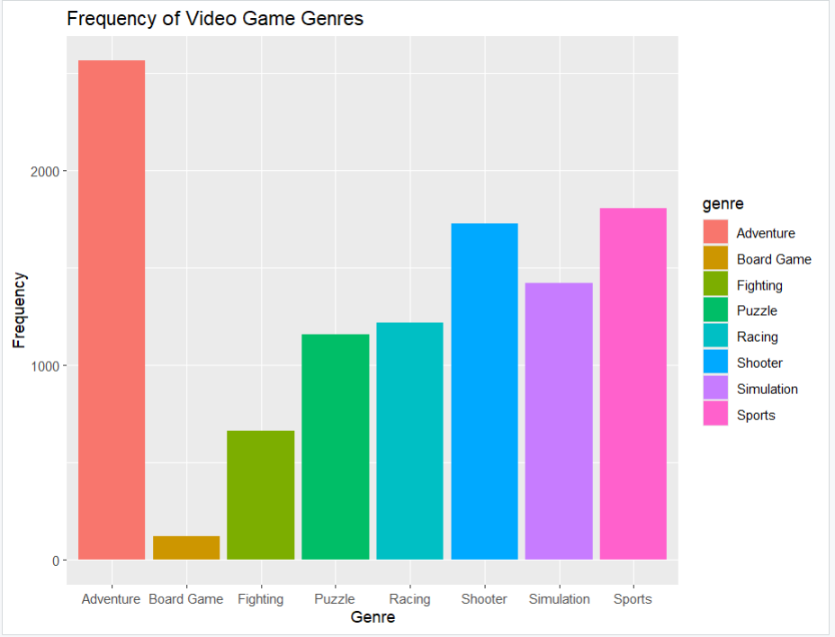
Frequency of game genres
The graph showcases a diverse range of video game genres, including Board Games, Fighting, Puzzle, Racing, Shooter, Simulation, and Sports.
The genre with the highest frequency is Adventure games, as represented by the tallest red bar, indicating a significant demand and popularity for these types of games

Slide 7
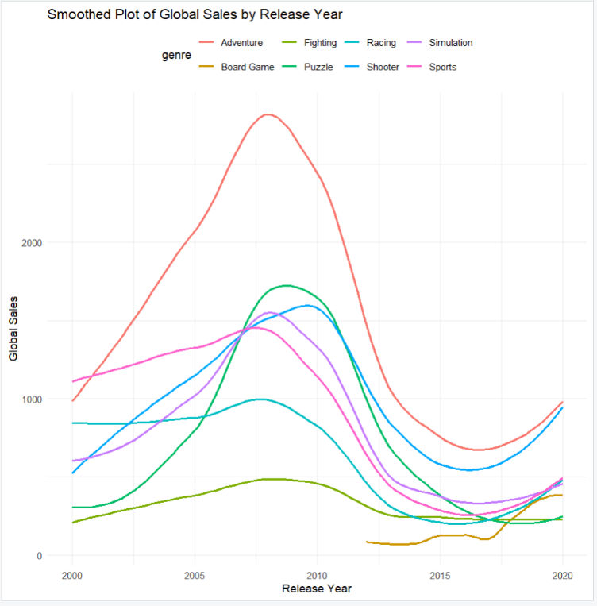
Sales ~ Genre per year
The plot reveals a distinct peak in global sales across most genres around the mid-2000s, suggesting a period of heightened demand and popularity for video games during that time.
Several genres, including Board Games (yellow line), Puzzle (orange line), and Shooter (light blue line), seem to experience a resurgence in sales in more recent years (around 2015-2020), indicating a renewed interest or evolving consumer preferences.
Genres like Sports (pink line) maintain a relatively consistent sales performance throughout the time period, suggesting a loyal and stable fanbase.

Slide 8
TOP PUBLISHERS BEHAVIOUR

Slide 9
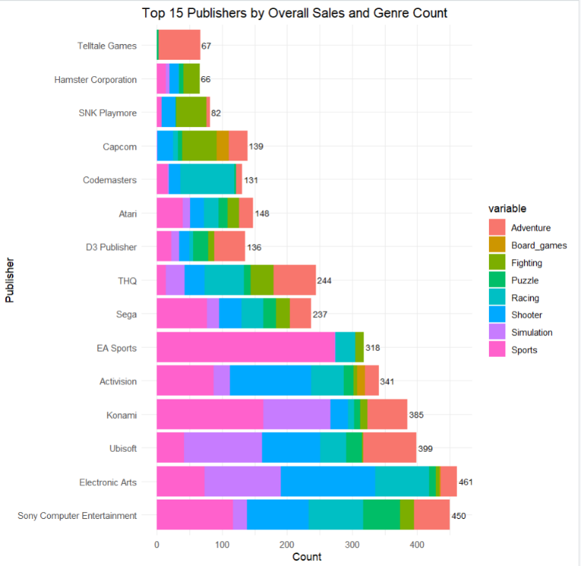
Top 15 Publishers
The plot only includes the top 15 publishers by overall sales and genre count, indicating a focus on major players in the gaming industry within the region.
It can be inferred that producing a high number of games does not mean high sales.
All these major publishers produced high no of games in a genre they are experts at.

Slide 10
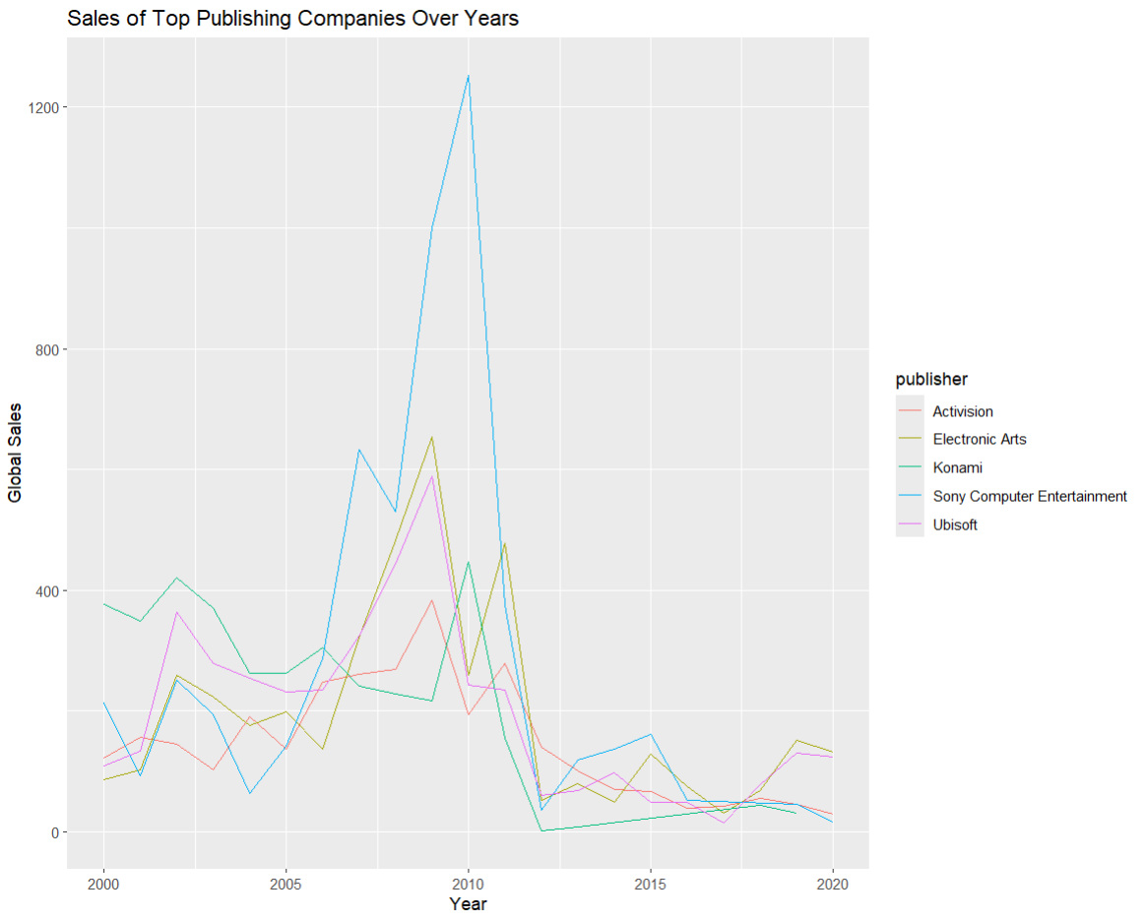

Slide 11
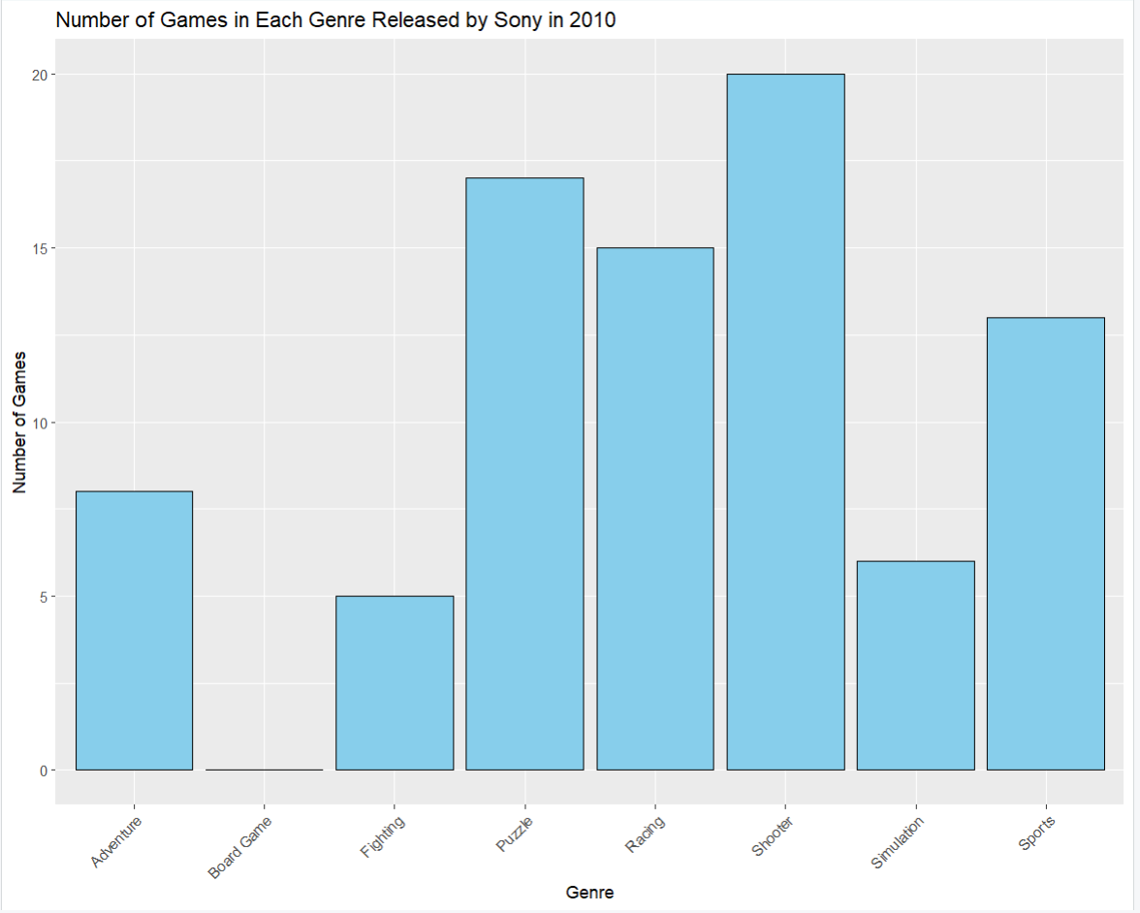
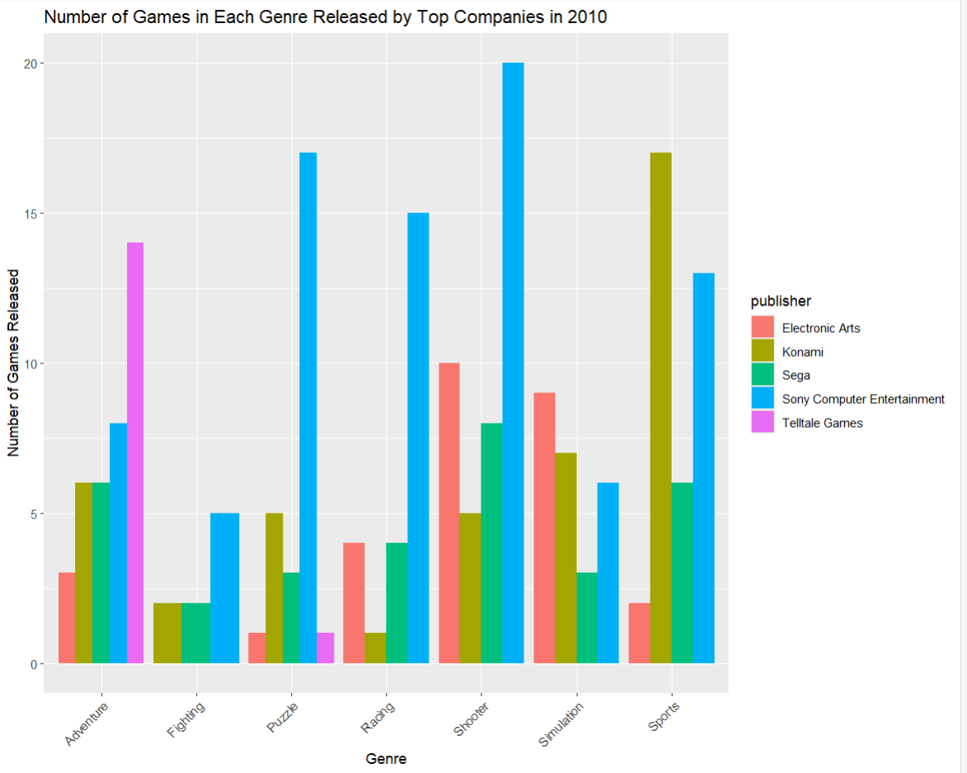

Slide 12
SALES ACROSS REGIONS

Slide 13
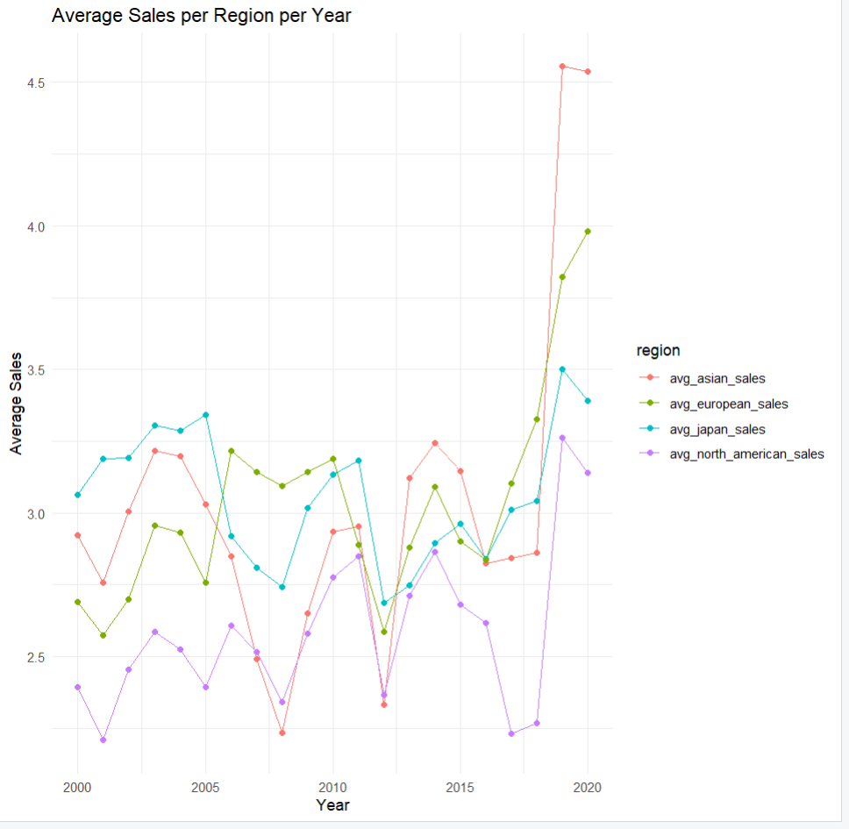
There is a significant spike in sales figures across all regions in the most recent years, starting around 2015-2020. This suggests a substantial sales growth in recent times.
The Asian region displays the highest average sales figures compared to other regions.
This tells us that the base number of video game players are high in Asian regions.

Slide 14
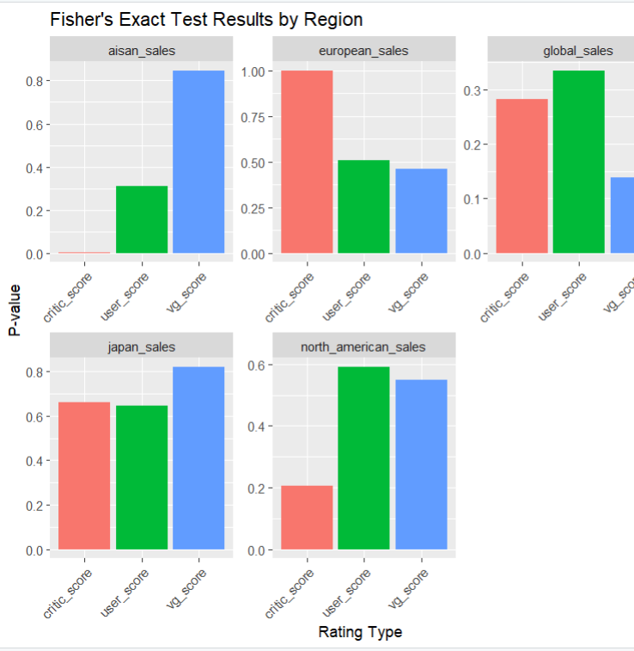
After doing further analysis on the data about what factors are effecting the sales in regions.
By doing fisher’s test it was found that the there is high probability of video game ratings from critic_scores, user ratings, vg_score certainly had an impact on those sales.

Slide 15
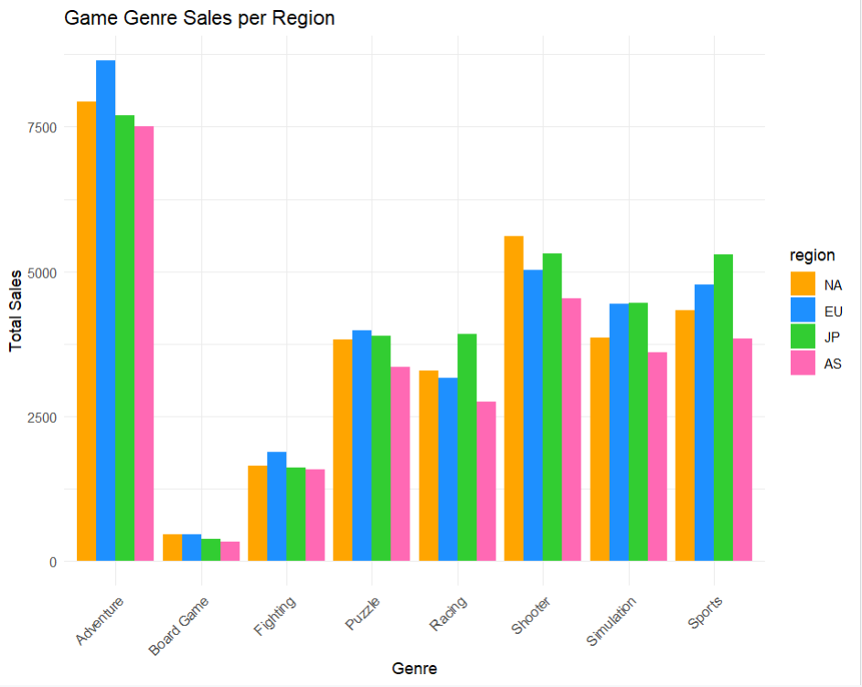
GENRE SALES IN REGIONS

Slide 16
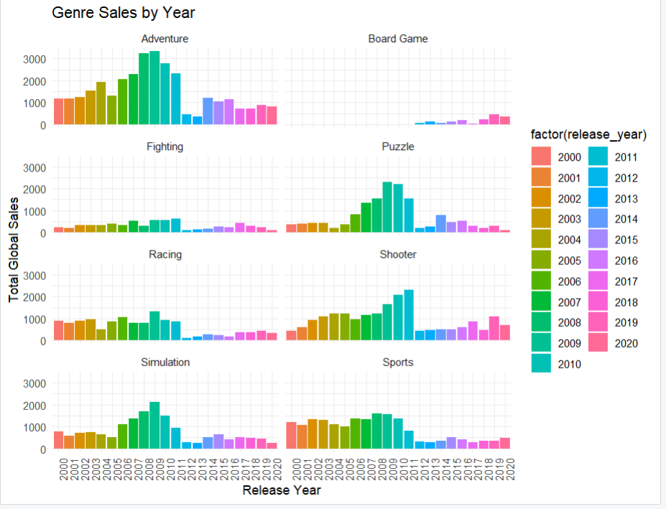
GENRE SALES PER YEAR

Slide 17
SALES ACROSS CONSOLES

Slide 18
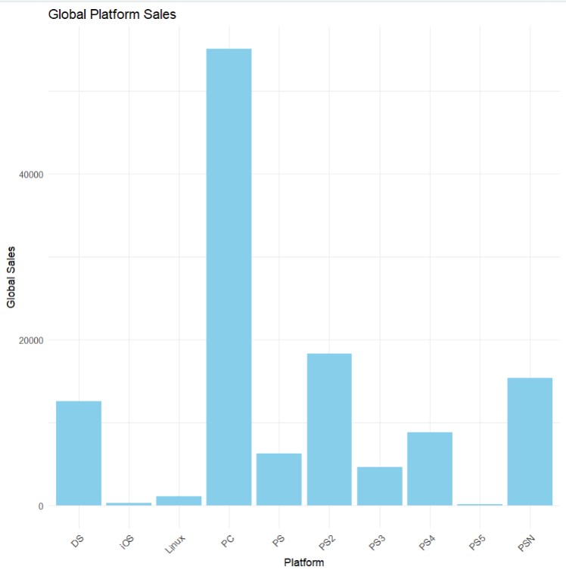
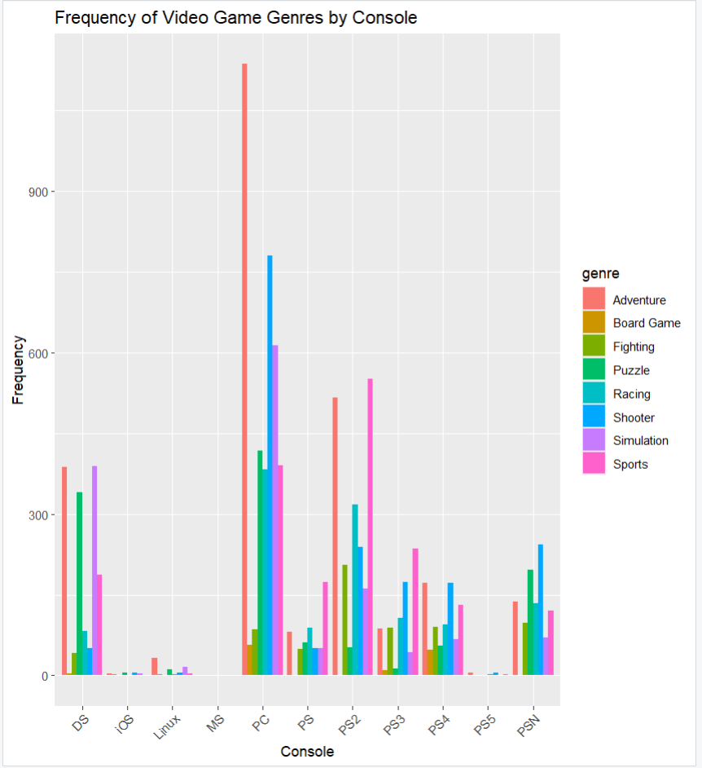
CONSOLE SALES GLOBALLY

Slide 19
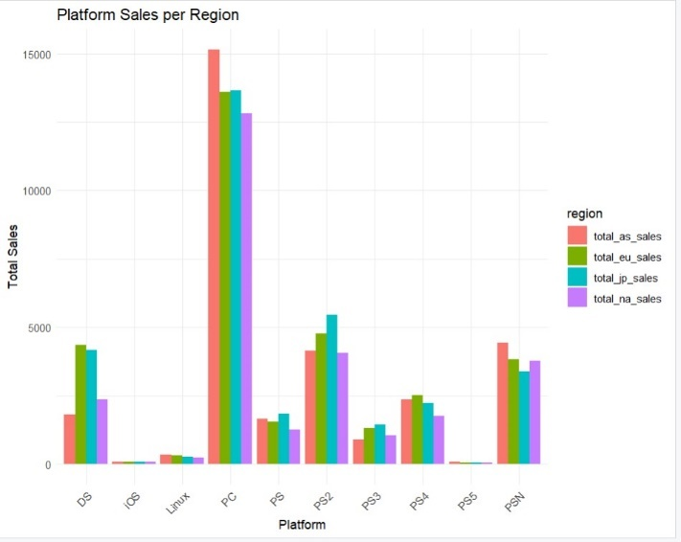
By breaking down the previous plot based on regions it can observed that the number of PC games sold were high in ASIA compared to other regions.
While the sales for IOS, PS5, LINUX are very negligible. The reason behind this maybe cost, release year, software architecture. Evidently leading to less sales.
The average number of video game sales are high in Asia.

Slide 20
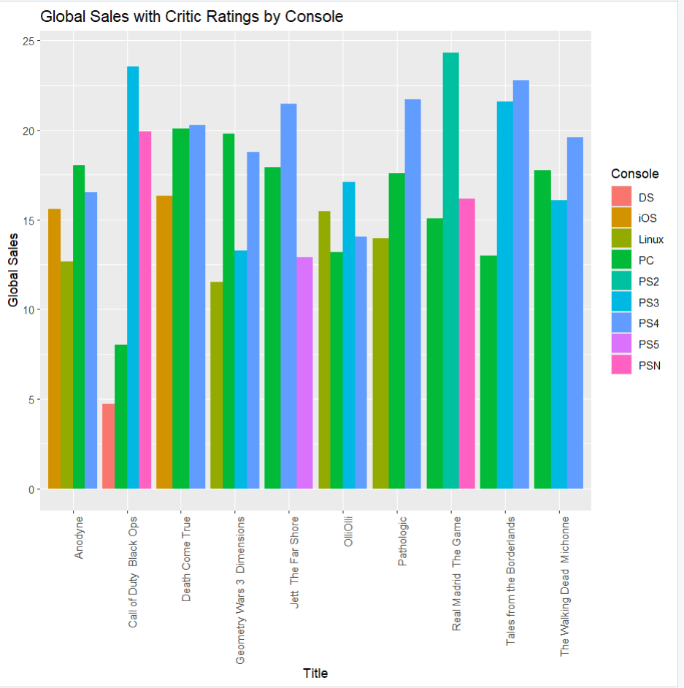
Top games by publishers across different consoles
Despite PC having high sales it is not having high sales for most of the top games.
As it can be observed from the plot that even though the top 10 games published for PC had comparatively less sales compared to other platforms these publishers still continued to produce games for this platform since the player base on PC is high. This makes that PC’s are assumably less effort platforms to develop games.

Slide 21
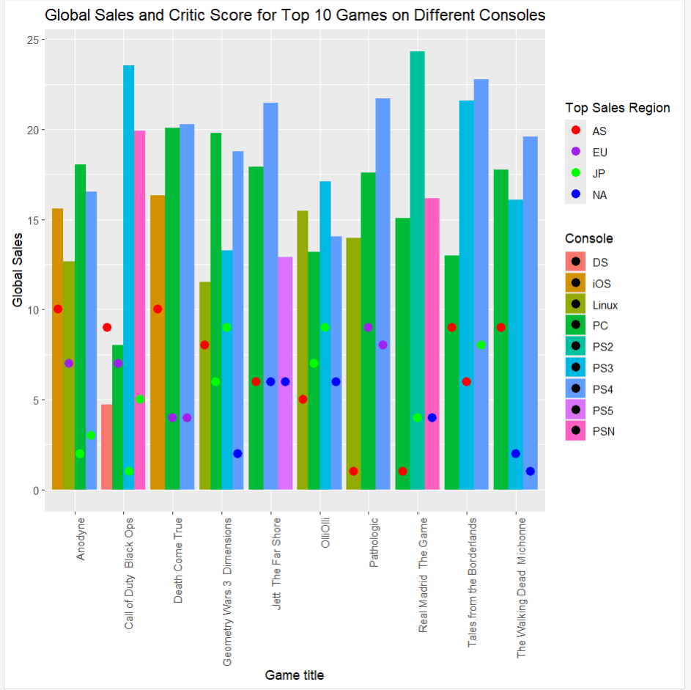
By viewing the global sales, critic scores on different consoles for different regions on single plot. we can analyse that the overall average sales are high for PC and PS3 making them the most preferred platform for playing games and Asia is the country with games as more popular, irrespective of the platform while proving that Asia sales does not have relation to the ratings produced by critic score.

